Slide 1
OFFICE APPLICATION
SPREADSHEET

Slide 2
Objectives
To explain the process of creating Spreadsheets

Slide 3
Creating Spreadsheets in Microsoft Excel
Opening Microsoft Excel
A) How to open Excel
Start menu search
Press the Windows key, type Excel, press Enter.
OR
Taskbar/Desktop icon
Click the Excel icon pinned to your taskbar or double-click the Excel shortcut on your desktop.

Slide 4
B) What you see when Excel opens
By default, many installations show a Start screen first (templates + recent files).
Click Blank workbook to get an empty sheet.
If the Start screen is disabled, Excel opens directly to a new Blank workbook (Sheet1).
How to control that behavior (Windows desktop Excel)
Go to File → Options → General → “Start up options.”
Uncheck “Show the Start screen when this application starts” → Excel opens directly to a blank workbook next time.
Check it to see templates/recent files first.

Slide 5
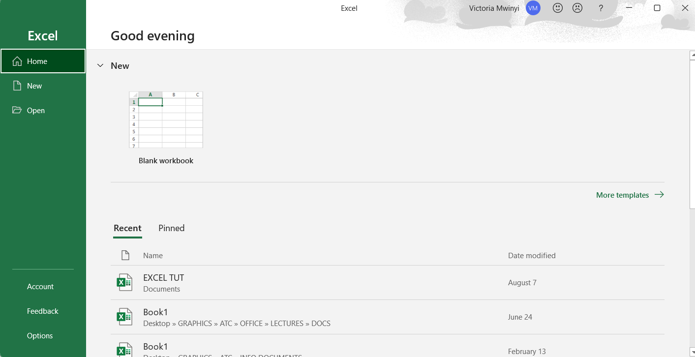

Slide 6
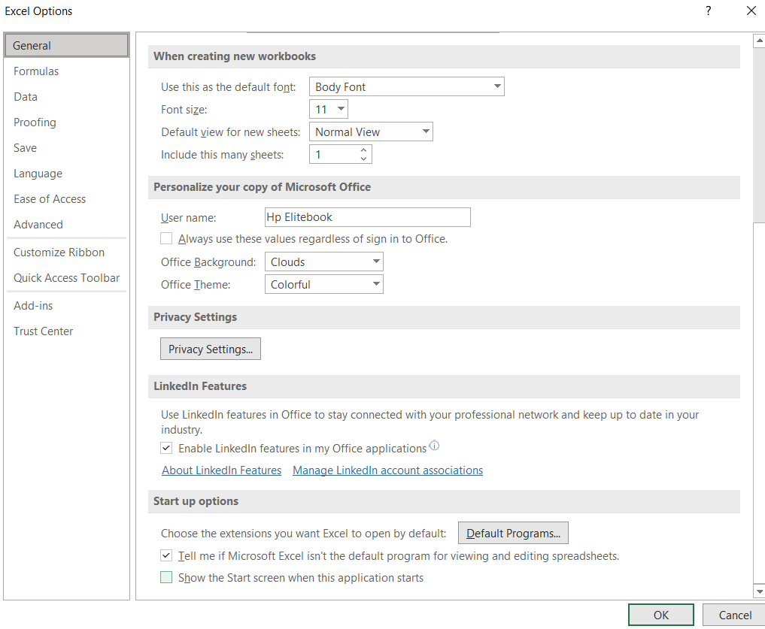

Slide 7
Entering Data
Entering data is the process of typing or inserting text, numbers, dates, or formulas into the cells of a worksheet for storage and processing.
Types of data you can enter
Excel is designed to handle a wide range of data types, and each type has its own special characteristics.
Text (also called Labels). This includes words, letters, or symbols that describe or identify data, such as “Student Name” or “Product A.” Excel stores text as information rather than numbers. Text cannot be used in calculations, but it is essential for headings, labels, and descriptions that make the worksheet easy to understand.

Slide 8
Numbers (or Values). Numbers are numeric entries that can be used for mathematical calculations, such as 120, 3.14, or -5. Excel allows numbers to be included in formulas and functions. Numbers are the foundation of most spreadsheet work because they can be added, subtracted, averaged, and processed using Excel’s built-in features.
Dates and Times. Dates are stored as serial numbers in Excel, where each date corresponds to a unique number, which makes it possible to perform calculations such as finding the number of days between two dates. Times are stored as fractions of a day, for example, 0.5 represents 12:00 noon. Both dates and times can be displayed in different formats depending on the user’s preference. A combination of date and time can also be entered in the same cell, which is useful for recording events with precise timestamps.

Slide 9
Currency and Percentages. Currency data allows numbers to be formatted with currency symbols like “$,” “£,” or “TZS,” making financial data easier to read and interpret. Percentages are stored as decimal numbers but displayed as percentages, for example, 0.5 is shown as 50%. This makes it easier to work with ratios, proportions, and financial or statistical data.
Logical or Boolean values. which are represented as either TRUE or FALSE. These are especially useful in logical tests and functions like IF, AND, or OR, where decisions or conditions are applied to the data. Logical values are the foundation of decision-making processes in Excel.
Formulas and Errors. Formulas are expressions that begin with an equals sign (=) and perform calculations using cell references and operators. For example, =A1+B1 adds the values in cells A1 and B1. Errors appear when Excel cannot perform a calculation properly, such as #DIV/0! for division by zero or #NAME? for an unrecognized function. These error values are important because they alert the user to mistakes in data entry or formulas.

Slide 10
Excel also allows users to insert Hyperlinks, Images, Charts, and Objects into worksheets.
Hyperlinks link to websites or other files, while
Images and shapes enhance presentation.
Charts are graphical representations of data and are created based on numbers and text entered into the worksheet.

Slide 11
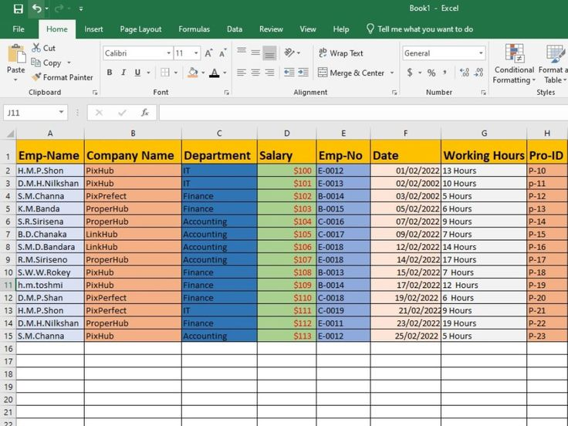

Slide 12
How to enter data:
Click on a cell (e.g., A1).
Type your text or number.
Press Enter to move down, or Tab to move right.
Tips:
Use AutoFill (drag the small square at the corner of a cell) to copy data or continue a series (e.g., Jan, Feb, Mar).
Always use headings (like Name, Marks, Total) in the first row for clarity.

Slide 13
Formatting Data
Formatting data means changing the appearance of cells, text, or numbers in a worksheet to make the information clear, attractive, and easier to understand.
Font & Text:
  Bold, Italics, Underline for emphasis.
  Font size and color for headings.
Cell Alignment:
  Align text left, center, or right.
  Use Wrap Text so long text fits inside a cell.
Number Formatting:
  Display numbers as currency, percentage, or decimal places.
  Example: 2500 → $2,500 or 25% depending on format.

Slide 14
Borders & Shading:
  Borders separate data areas.
  Shading (Fill Color) highlights important rows or headers.
Cell Styles:
  Predefined themes for headers and titles.

Slide 15
Using Formulas and Functions
Formula: A formula is a user-defined mathematical expression in Excel that performs a calculation using cell references, operators, and values (e.g., =A1+B1).
Function: A function is a built-in predefined command in Excel that performs a specific calculation or operation automatically (e.g., =SUM(A1:A5)).
Formulas
Always begin with =.
Use cell references instead of typing numbers.
Example: =B2+B3 adds the values in B2 and B3.

Slide 16
Common Functions in Excel
i. SUM
Adds a range of numbers.
Formula: =SUM(A1:A5)
Example: Adds values from cell A1 to A5.
ii. AVERAGE
Finds the average (mean) of numbers.
Formula: =AVERAGE(B1:B10)
Example: Calculates the average mark of students in cells B1 to B10.
iii. MIN
Finds the smallest value in a range.
Formula: =MIN(C1:C8)
Example: Shows the lowest score in a list.

Slide 17
iv. MAX
Finds the largest value in a range.
Formula: =MAX(C1:C8)
Example: Shows the highest score in a list.
v. COUNT
Counts the number of cells with numbers.
Formula: =COUNT(D1:D20)
Example: Counts how many students have numeric marks.
vi. COUNTA
Counts all non-empty cells (numbers or text).
Formula: =COUNTA(A1:A10)
Example: Counts how many names are listed.

Slide 18
vii. IF
Tests a condition and returns a value if TRUE or FALSE.
Formula: =IF(E1>=50,"Pass","Fail")
Example: If marks in cell E1 are 50 or more, shows “Pass,” otherwise “Fail.”
viii. TODAY
Displays the current date.
Formula: =TODAY()
Example: Shows today’s date in the cell.
ix. NOW
Displays the current date and time.
Formula: =NOW()

Slide 19
ix. ROUND
Rounds a number to a given number of decimal places.
Formula: =ROUND(F1,2)
Example: Rounds value in F1 to 2 decimal places.
x. ROUNDUP / ROUNDDOWN
Rounds a number up or down, regardless of decimal value.
Formula: =ROUNDUP(4.2,0) → 5
=ROUNDDOWN(4.8,0) → 4
xi. TRIM
Removes extra spaces from text.
Formula: =TRIM(A1)

Slide 20
Advantages of using functions
Save time compared to manual formulas.
Reduce errors.
Update automatically when data changes.

Slide 21
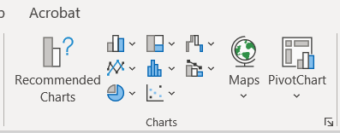
Creating Charts
Creating charts is the process of converting worksheet data into visual representations such as bar charts, pie charts, or line charts to make comparisons and trends easier to understand.
Steps to create a chart
Highlight your data (including headings).
Go to Insert tab → Charts group.
Select chart type:
  Column/Bar Chart: Compare individual values (e.g., student marks).
  Pie Chart: Show proportions (e.g., contribution of each student to total marks).
  Line Chart: Show trends over time.
The chart appears in the worksheet.

Slide 22
Saving a Workbook
Saving a workbook is the process of storing the current Excel file on a computer, external storage, or cloud service so that the work can be retrieved and used later.
Saving ensures that your work is not lost.
Steps to Save
Click File → Save As.
Choose location (Desktop, Documents, Flash drive).
Type a filename (e.g., Student_Results.xlsx).
Click Save.
Quick Save
Use Ctrl + S frequently while working.
File Formats
.xlsx → default Excel format, .xls → older Excel versions, .csv → for plain text data.

Slide 23
Editing and Updating
Editing and updating is the process of making changes to an existing spreadsheet, such as modifying data, inserting or deleting rows and columns, or applying new formatting to keep the information current and accurate.
Insert or Delete: Right-click a row/column → choose Insert or Delete.
Update Values: Click on a cell and type new data (Excel automatically updates related formulas).
Copy & Paste: Duplicate data using Ctrl + C (Copy) and Ctrl + V (Paste).
Sort Data: Rearranges alphabetically, numerically, or by date.
Filter Data: Display only specific records. It hides unwanted data temporarily.
Find & Replace: Replace repeated text or numbers (Ctrl + H).
Undo/Redo: Undo mistakes with Ctrl + Z, Redo with Ctrl + Y.

Slide 24
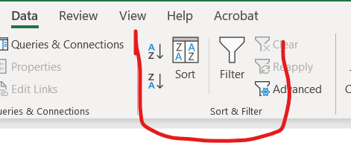
How to Sort in Excel
Open your Excel file and select the column you want to sort.
Go to the Data tab on the Ribbon.
To sort text → Click A to Z (alphabetical order) or Z to A (reverse order).
To sort numbers → Click Smallest to Largest or Largest to Smallest.
To sort dates → Click Oldest to Newest or Newest to Oldest.
If you want to sort by more than one column (e.g., Class then Name), click Sort → choose your columns.

Slide 25
How to Filter in Excel
Select the data range you want to filter (include headers like “Name” or “Marks”).
Go to the Data tab → click Filter.
Small drop-down arrows will appear on each column header.
Click the arrow in the column you want to filter.
  For Text: choose specific items (e.g., only “Form A”).
  For Numbers: choose conditions like “Greater than 50.”
  For Dates: choose periods like “This Month” or “Last Year.”
Excel will hide rows that don’t match your selection, and show only the records you need.
To remove the filter, click the Filter button again or select Clear Filter.

Slide 26
END

