Slide 1
OFFICE APPLICATION
PROCESSING WORD

Slide 2
Objectives
Explain the process of creating documents
Format the document
Insert image into a document

Slide 3
Process of Creating a Document in
Microsoft Word
Steps:
Open Microsoft Word – Click the Word icon from Start Menu or Desktop.
Create a new document – Choose Blank Document.
A white page (document) opens, ready for typing.
Type your content – e.g., "This is my first Word document.“
Save the document –
    Click File → Save As
    Choose the location (Desktop or Documents)
    Give it a name (e.g., My Work)Click Save
    Shortcut: Ctrl + S saves quickly.

Slide 4
Formatting a Document in Microsoft Word
Formatting a document in Microsoft Word means arranging or changing the appearance or look of the text, paragraphs, and pages to make the document neat, readable, and professional.
It does not change the actual words you have written, but only how they are displayed.

Slide 5
Main formatting tools are in the Home Tab:
Font group: Change font type (e.g., Calibri, Times New Roman), size (10, 12, 14), Bold (Ctrl+B), Italic (Ctrl+I), Underline (Ctrl+U).
Paragraph group:
  Align text: Left, Center, Right, or Justify.
  Add bullets or numbering.
  Adjust line spacing (1.0, 1.5, 2.0).
Styles group: Apply heading styles like Heading 1, Heading 2, Heading 3, Heading 4 for titles.
Page Layout tab: Change page margins, orientation (Portrait/Landscape), and page size (A4, Letter).

Slide 6
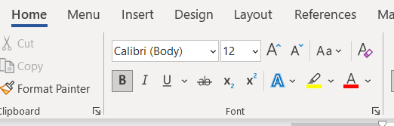
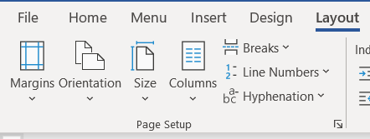
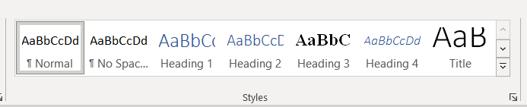
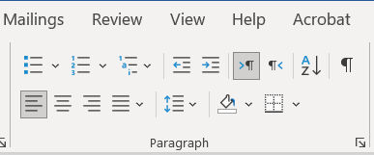
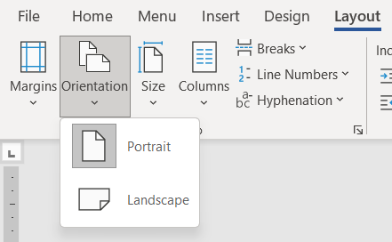

Slide 7
Insert an Image into a Microsoft Word Document
Steps:
Place the cursor where you want the picture.
Go to Insert Tab → Pictures → This Device (to insert from computer).
  Or choose Online Pictures if you want from the internet.
Select the image and click Insert.
The picture will appear in your document.

Slide 8
To adjust:
    Resize: Drag the corners of the image.
Click the image → go to Picture Tools Format Tab → Wrap Text
Choose In Line with Text, Square, Tight, Behind Text, or In Front of Text.

Slide 9
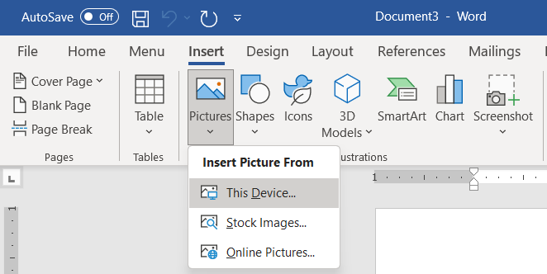

Slide 10
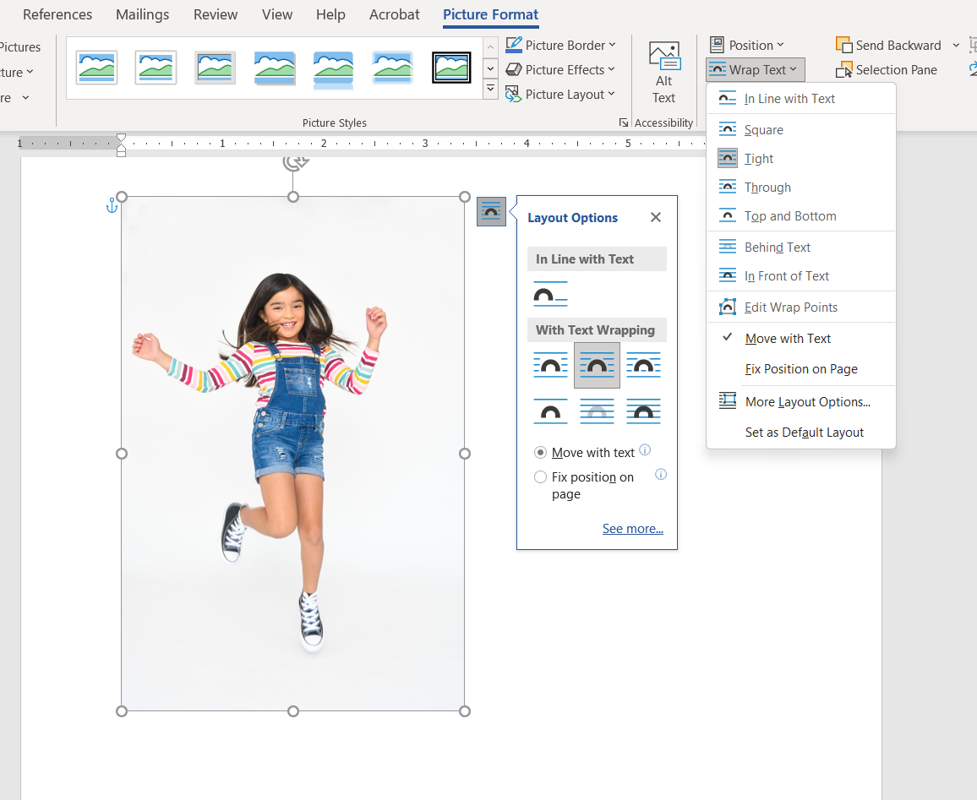

Slide 11
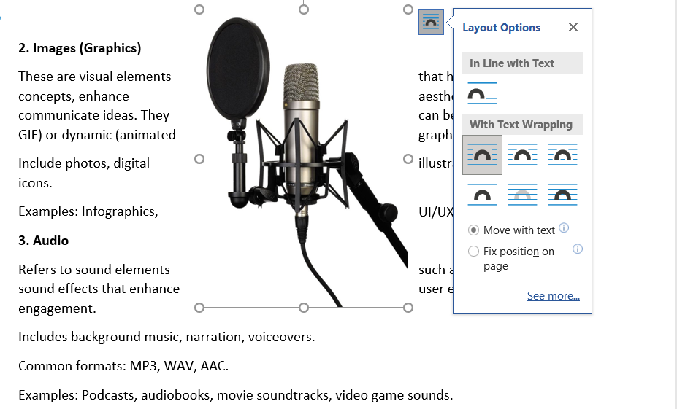

Slide 12
Final Summary of the whole process of creating a Document In Microsoft Word
Open Word → New Blank Document.
Type your content.
Format using Home and Layout tabs.
Insert images, tables, or charts if needed.
Save the document properly.

