Slide 1
OFFICE APPLICATION
DATABASE APPLICATION

Slide 2
Objectives
To explain forms as applied to database application
To describe the procedure of creating Forms
To identify the navigation tools used in a Form
To explain the advantages of entering data in a Form
To explain Reports as applied to database application
To describe the procedure of creating Report
To explain report generators

Slide 3
Forms
Definition
A Form is a user-friendly interface for entering, viewing, and editing data in a database.
  Example: A Student Registration Form used to input new student details.

Slide 4
Procedure of Creating Forms
Go to Create → Form or Form Design.
Select the table.
Choose fields to include.
Arrange the layout.
Save and open the form.

Slide 5
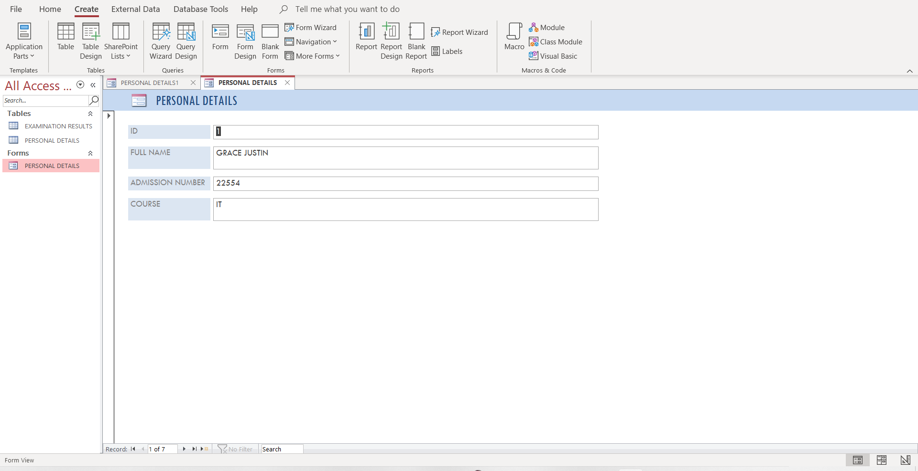

Slide 6

Navigation Tools in a Form
First Record: Go to the first entry.
Previous Record: Move one step back.
Next Record: Move one step forward.
Last Record: Go to the final entry.
New Record: Add a new entry.

Slide 7
Advantages of Using Forms
Easier for beginners to enter data.
Reduces typing and entry errors.
Provides a professional interface with controls like drop-downs and checkboxes.
Helps maintain consistent data entry.

Slide 8
Reports
Definition
A Report organizes and presents data in a professional, printable format.
Example: A report showing all students grouped by Department with their GPA averages.

Slide 9
Procedure of Creating a Report
Go to Create → Report Wizard.
Select the table or query to use.
Choose fields to include.
Choose layout and formatting style.
Save the report.

Slide 10
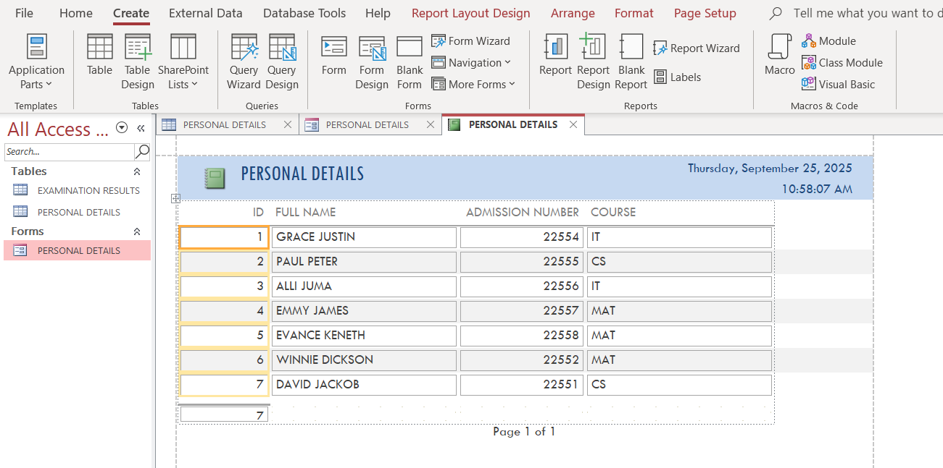

Slide 11
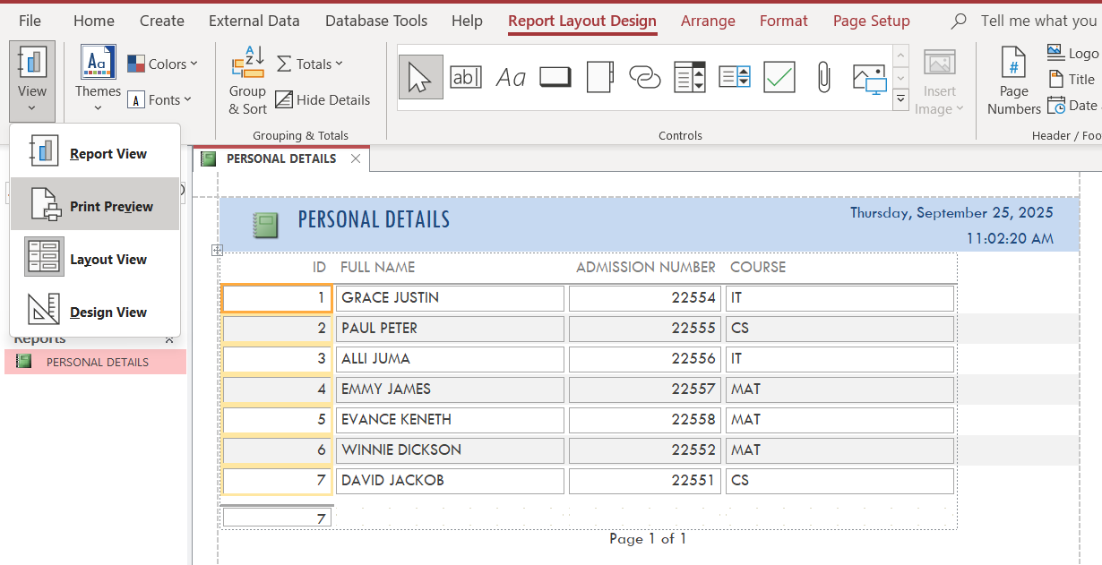

Slide 12
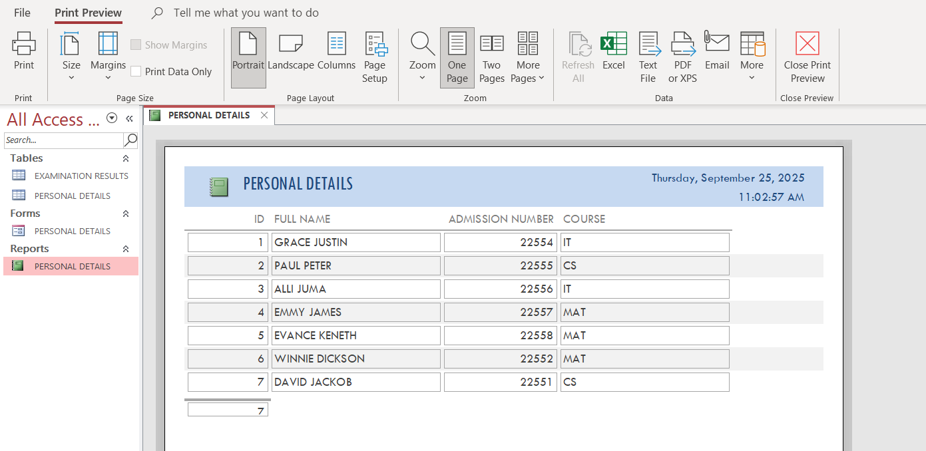

Slide 13
Report Generators
Report Wizard: Guided, fast report creation.
Design View: Full control to customize.
Layout View: Drag-and-drop formatting.

Slide 14
END

