Slide 1
OFFICE APPLICATION
DATABASE APPLICATION

Slide 2
Objectives
To explain key terms used in different types of database
To explain the importance of database application
To describe procedure of creating database and Tables
To explain on how to analyze the problems of database table

Slide 3
Key terms used in different types of database
Database: An organized collection of related data stored electronically.
  Example: A school database storing students’ personal details, subjects, and grades.
Table: The basic building block of a database, storing data in rows and columns.
  Example: A “Students” table with rows as student records and columns as fields like Name, Age, and Department.
Field: A column in a table that stores one type of data.
  Example: “Age” field stores ages of students.
Record: A row in a table that contains one complete entry.
  Example: (StudentID: 101, Name: John, Age: 20, Department: IT).

Slide 4
Primary Key: A unique identifier for each record in a table.
  Example: StudentID in a Students table.
Relationship: A link between two or more tables through a common field.
  Example: Linking StudentID in the “Students” table with StudentID in the “Grades” table.
Data Type:

Slide 5
Importance of Databases
Store and manage large volumes of data efficiently.
Reduce duplication of information and errors.
Allow quick searching and retrieval of specific data.
Enable multiple users to access and update information.
Support better decision-making.
  Example: A hospital database helps doctors quickly access patient history.

Slide 6
Procedure of Creating a Database and Tables
To Create a Database
Open Microsoft Access.
Select Blank Database.
Name the database (e.g., StudentDB).

Slide 7
Creating Tables
Go to Create → Table Design.
Define fields with names and data types (e.g., StudentID, Name, Admission Number, and Course).
Set a Primary Key.
Save the table with a proper name.
Go to Datasheet View and Start entering data irrespectively.

Slide 8
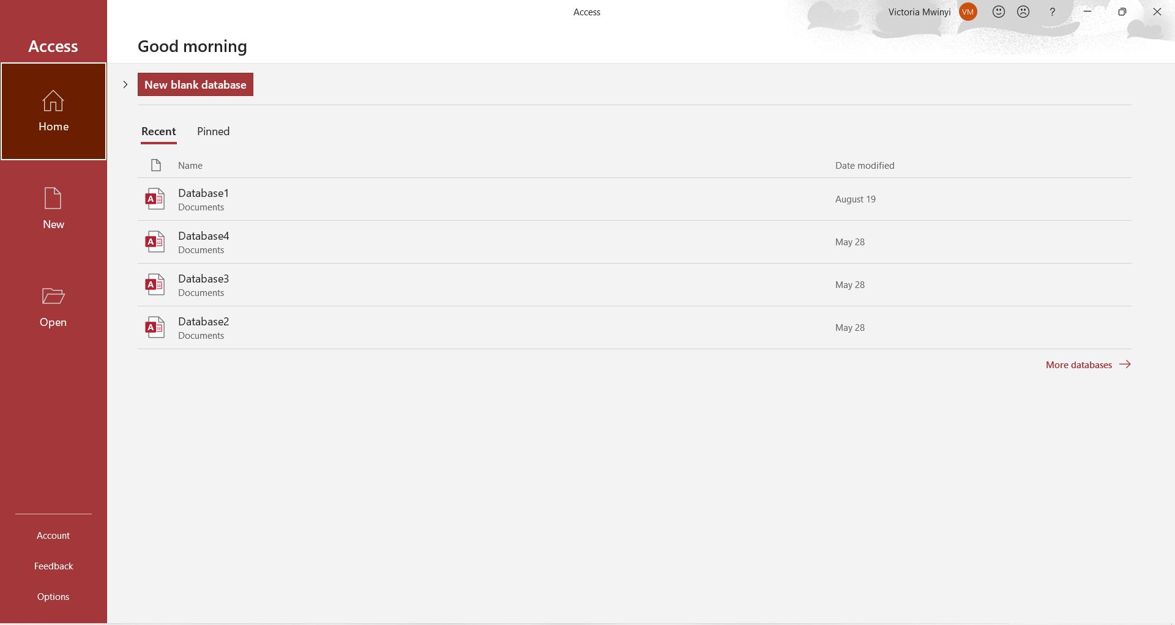

Slide 9


Slide 10
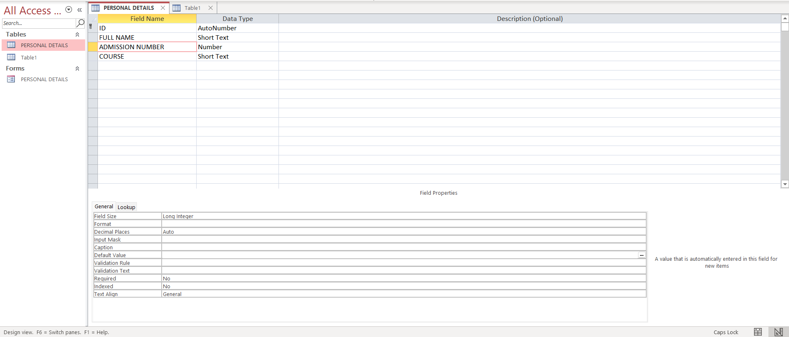
Table in Design View

Slide 11
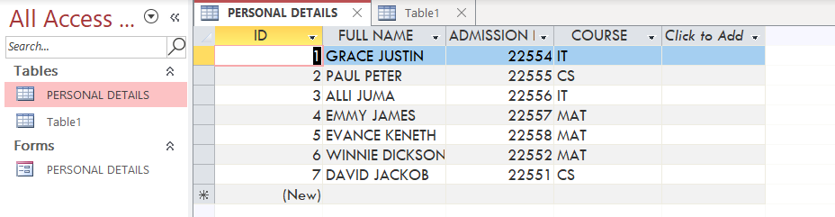
Table in Datasheet View

Slide 12
Analyzing Problems in Database Tables
Missing primary key → leads to duplicate records.
Redundant fields → cause unnecessary repetition of data.
Wrong data types → may result in errors (e.g., typing letters in a “Number” field).
Poor relationships → can cause inconsistent data.

Slide 13
END

